Slide 1
Invasive Species
Environmental and Natural Resources CDE

Slide 2
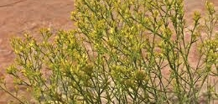
Notes:
Broom Snake Weed

Slide 3
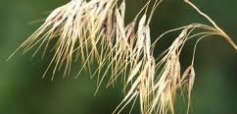
Notes:
cheatgrass

Slide 4
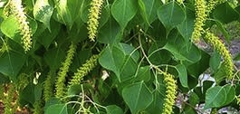
Notes:
Chinese tallow

Slide 5
Notes:
cogongrass

Slide 6
Notes:
English Ivy

Slide 7
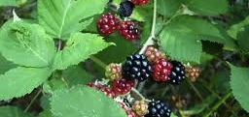
Notes:
Himalaya Blackberry

Slide 8
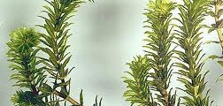
Notes:
hydrilla

Slide 9
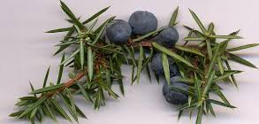
Notes:
juniper

Slide 10
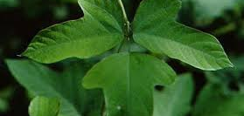
Notes:
kudzu

Slide 11
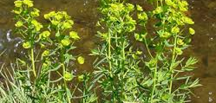
Notes:
Leafy spurge

Slide 12
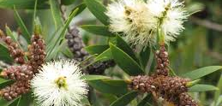
Notes:
melaleuca

Slide 13
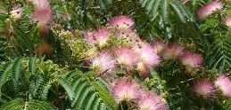
Notes:
Mimosa tree

Slide 14
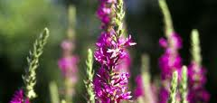
Notes:
Purple loosestrife

Slide 15
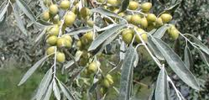
Notes:
Russian olive

Slide 16
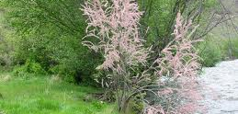
Notes:
saltcedar

Slide 17
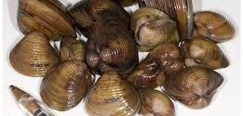
Notes:
Asiatic clam

Slide 18
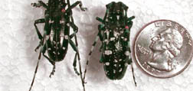
Notes:
Asian long-honed beetle

Slide 19
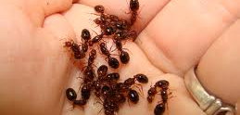
Notes:
Fire ant

