Slide 1
ID Presentation
Environmental and Natural Resources

Slide 2
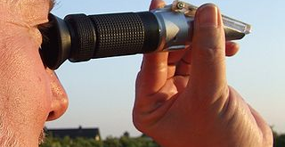
101. refractometer

Slide 3
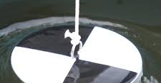
102. Secchi disk
Notes:
The Secchi disk, as created in 1865 by Angelo Secchi, is a plain white, circular disk (30 cm in diameter or approximately 12 inches) used to measure water transparency in oceans. The disc is mounted on a pole or line, and lowered slowly down in the water. The depth at which the disk is no longer visible is taken as a measure of the transparency of the water. This measure is known as the Secchi depth and is related to water turbidity. Since its invention the disk has also been used in a modified, smaller 20 cm diameter, black and white design to measure freshwater transparency.

Slide 4
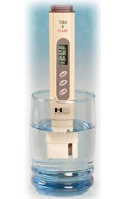
103. thermometer

Slide 5
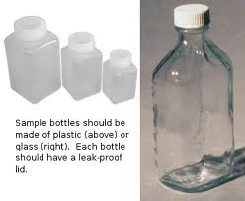
104. Water bottle samplers

Slide 6
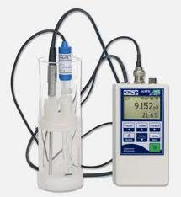
105. Water meter

Slide 7
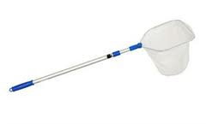
107. Aquatic net

Slide 8
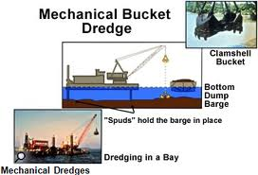
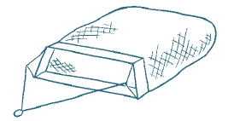
108. Bottom dredges

Slide 9
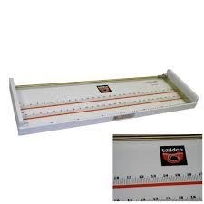
109. Fish Measuring Board

Slide 10
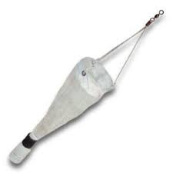
110. Plankton net

Slide 11
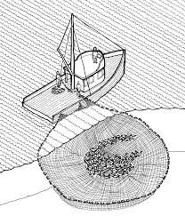
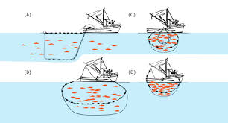
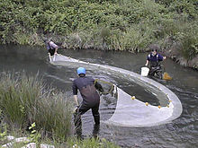
111. seines
Notes:
Seine fishing (or seine-haul fishing) is a method of fishing that employs a seine or dragnet. A seine is a fishing net that hangs vertically in the water with its bottom edge held down by weights and its top edge buoyed by floats. Seine nets can be deployed from the shore as a beach seine, or from a boat.

Slide 12
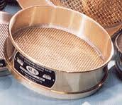
112. Sieves

Slide 13
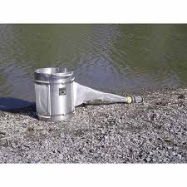
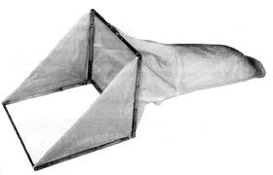
113; stream bottom sampler

